Slide 1

Taxi station management system
24-1-D-15
Supervisor:
Zeev Barzily
Date:
22/09/2024
Shorok Heib 315959429
Emad Suliman 322386558

Slide 2

Concise description
This project focuses on developing an efficient and organized management system for taxi stations to address current inefficiencies in day-to-day operations, including coordination between staff, booking management, driver and vehicle oversight, and performance monitoring.

Slide 3
Motivation
The project aims to improve taxi service efficiency by offering a customized solution for management teams, optimizing operations, enhancing customer satisfaction, and meeting urban transportation demands.

Slide 4
Our Solution
The solution is the Taxi Station Management System, with secretaries handling bookings and dispatch, and managers overseeing performance and making strategic decisions based on reports and analytics.

Slide 5
Introduction
Our Taxi Station Management System uses ReactJS and Node.js to offer real-time data synchronization, secure access, and efficient operations management, streamlining driver coordination, booking management, and performance analysis. This system enhances operational efficiency and customer satisfaction, addressing the evolving needs of urban transportation.

Slide 6
Project Goals & Unique Features:
Efficient Operations Management: Implement a system for streamlined scheduling, bookings, and maintenance at the taxi station.
Employee Management: Allow the station manager to recruit, manage, and schedule employees based on qualifications, availability, and roles.
Driver and Vehicle Tracking: Enable real-time tracking of drivers and vehicles to optimize dispatching and integrate leading vehicles into future trip planning.
Maintenance and Service Management: Coordinate vehicle maintenance and repairs with the workshop, ensuring prompt issue handling and tracking repair status.

Slide 7
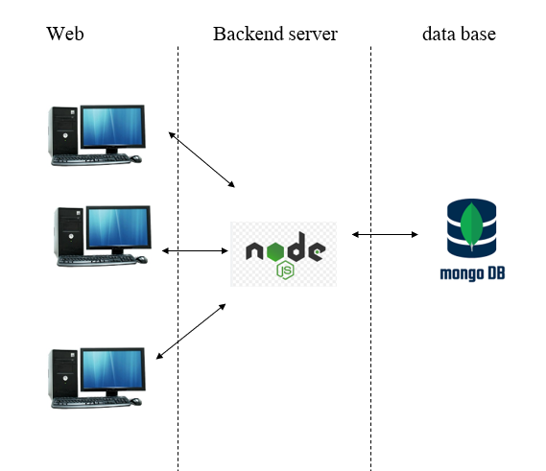
Software architecture
Notes:
Frontend (React-based):
React Components: We used different parts of our messaging app, like scheduling messages, chatting with users, and managing groups, as separate building blocks called components. This made it easy to add new features without messing up the rest of the app.
Routing (React Router): Think of React Router as a map that helps you move around our app. It lets you switch between different pages, like the home page, chat rooms, and user profiles, smoothly without having to reload the whole page.
Styling: Making our app look good was important, so we used different techniques for styling. We used CSS for basic styles, CSS Modules to keep styles organized, and Styled Components to create stylish components right in our code.
Backend (Node.js-based):
Express.js: This is like the engine that powers our server. It's a simple framework for building web applications and handling requests from users.
Routing: We set up routes in our server to handle different types of requests from users. This helps keep our code organized and easy to manage.
Authentication and Authorization: We made sure only the right people can access certain parts of our app by using methods like JWT for authentication and session-based authentication for managing user sessions.
Database:
MongoDB: This is where we store all the important data for our app. It's a flexible database that's great for handling lots of different types of information.
In our database, we have different collections (kind of like folders) for storing specific types of data:
User Collection: Stores information about users, like their username, email, and role.
Group Collection: Keeps track of all the groups in our app, who created them, and their message history.
Message Collection: Stores individual messages, including who sent them and when.
User Message Collection: Specifically for one-on-one chats between users.
These collections help organize our data and make sure everything runs smoothly in our app.

Slide 8



Technologies and specialized software tools
Notes:
1. React (Frontend):
- A JavaScript library used to build dynamic and interactive user interfaces (UI). It allows you to create reusable components that handle specific parts of the UI.
2. Node.js (Backend):
- A runtime environment that lets you run JavaScript on the server side. It handles requests from the frontend and processes them, often using Express.js to create a server.
3. MongoDB (Database):
- A NoSQL database that stores data in flexible, JSON-like documents. It's used to store and manage all necessary data for the taxi station system, like taxis, drivers, and trip histories.
In the code:
- React sends requests to the Node.js server to get or send data.
- Node.js processes these requests and interacts with MongoDB to retrieve or update data.
- The data is then sent back to React, which updates the UI accordingly.

Slide 9
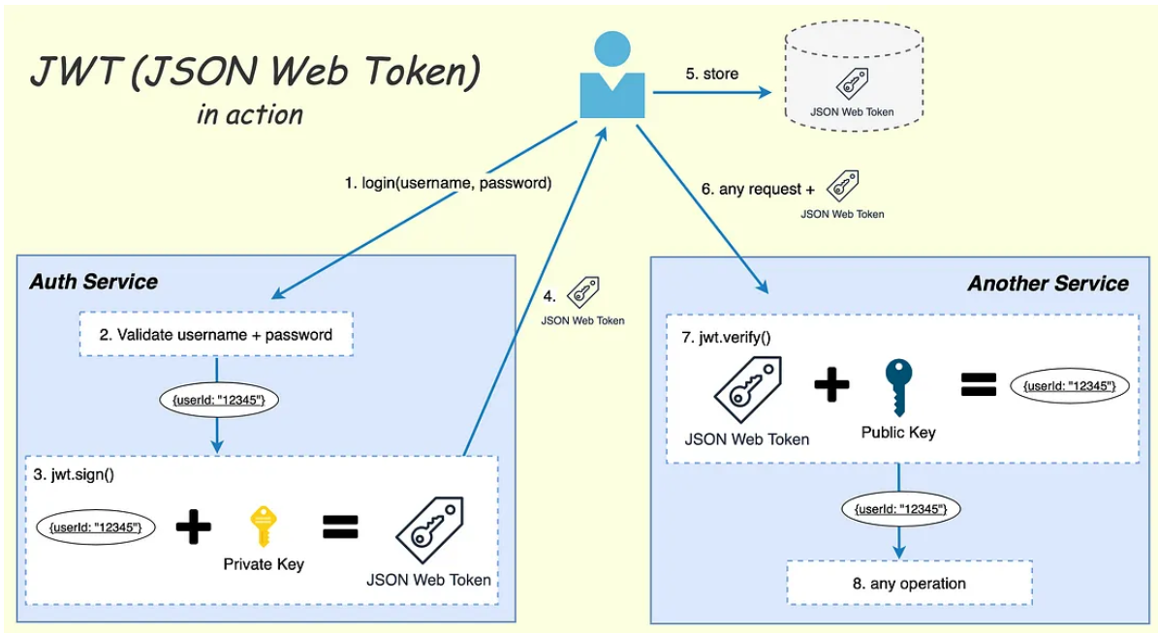
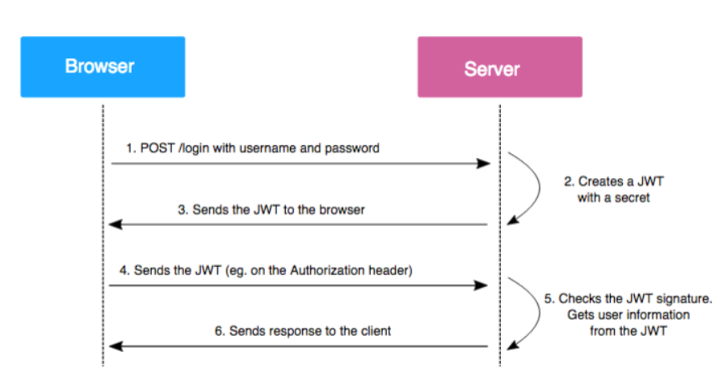
Enhancing Security

Slide 10

Testing
We documented each action in a table and then verified their functionality on the system.
The results of our tests were recorded in the table, allowing us to ensure that our system is working correctly, and users can perform their desired actions without any problems.
Notes:
For testing our system, We documented each action in a table and then verified their functionality on the system. The results of our tests were recorded in the table, allowing us to ensure that our system is working correctly, and users can perform their desired actions without any problems.

Slide 11
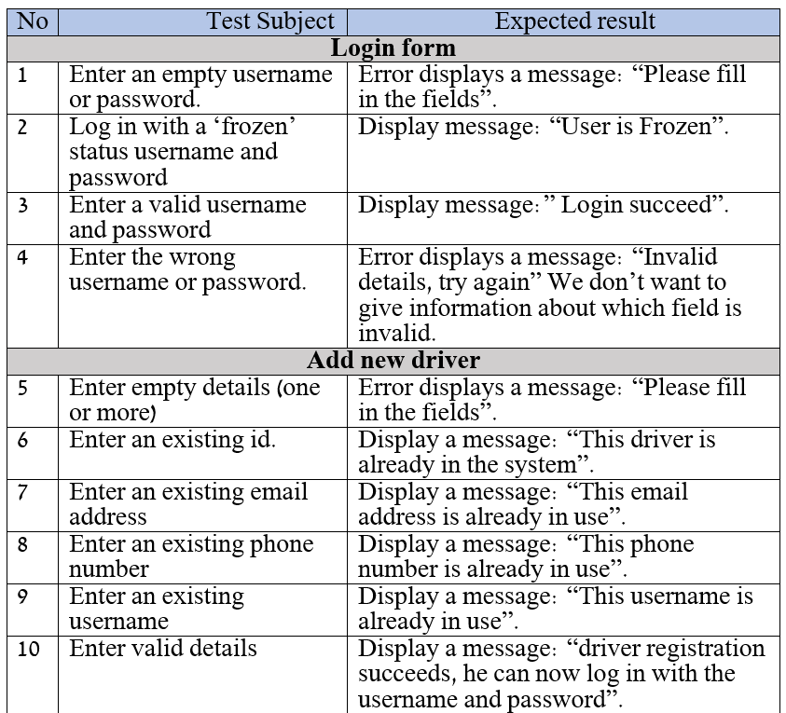
Testing

Slide 12
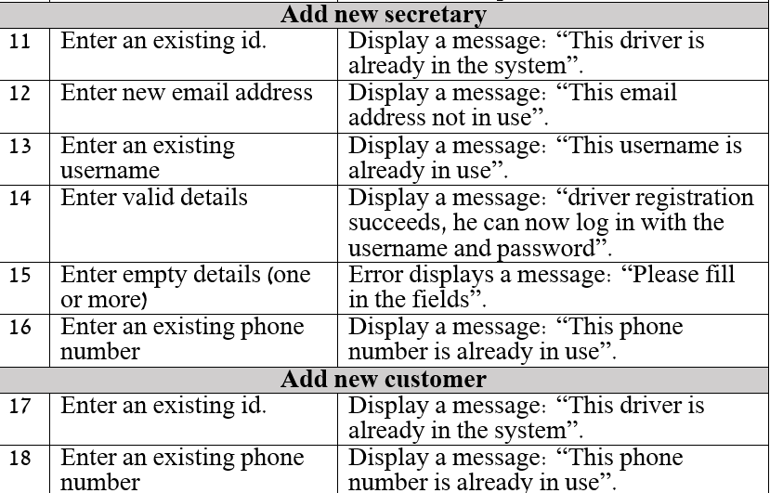
Testing

Slide 13
We use several important metrics to monitor the development and performance of our project.
1. User Satisfaction: Gather feedback from users to ensure the system meets their needs.
Notification Delivery Speed: We measure the time it takes for notifications to reach client to ensure timely communication and prompt updates.
Performance Optimization: We make sure our system runs smoothly by keeping an eye on how fast it responds, how long it takes to load, and how efficiently it uses resources. This helps us fix any problems quickly and ensures a better experience for users.
Notes:
2. Notification types include booking confirmations, maintenance updates, schedule changes, and performance alerts.

Slide 14

Challenges:
Frontend-Backend Coordination
Unexpected Bugs and Issues
Time managing even if we have many tasks to do at the same time.​
Notes:
Frontend-Backend Coordination: Integrating React on the frontend with Node.js on the backend required precise coordination regarding API interfaces. Any change in the API on the backend necessitated corresponding updates on the frontend to avoid errors and ensure consistent system behavior.
Unexpected Bugs and Issues: During development, we encountered bugs and issues that were not anticipated, causing delays that required resolution.

Slide 15
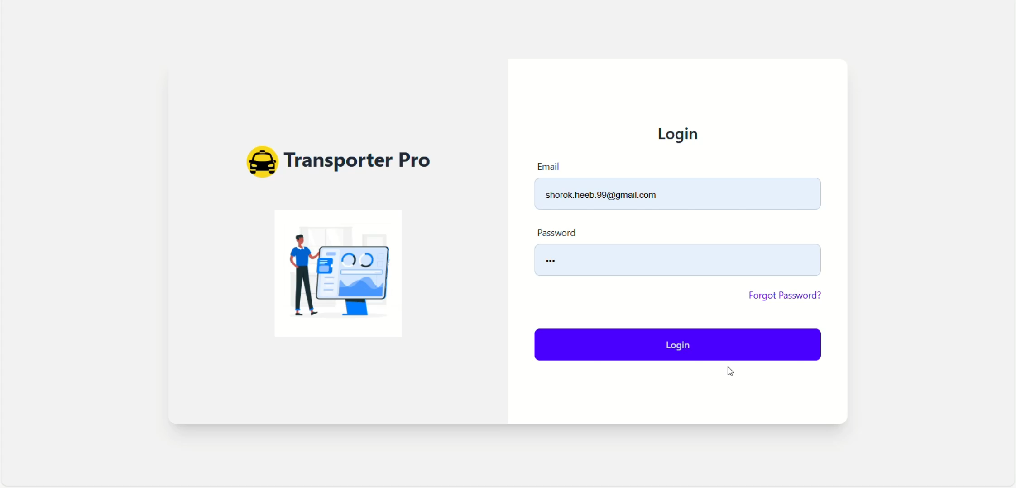
Video for how the system works:

Slide 16

Thank you

